Slide 1
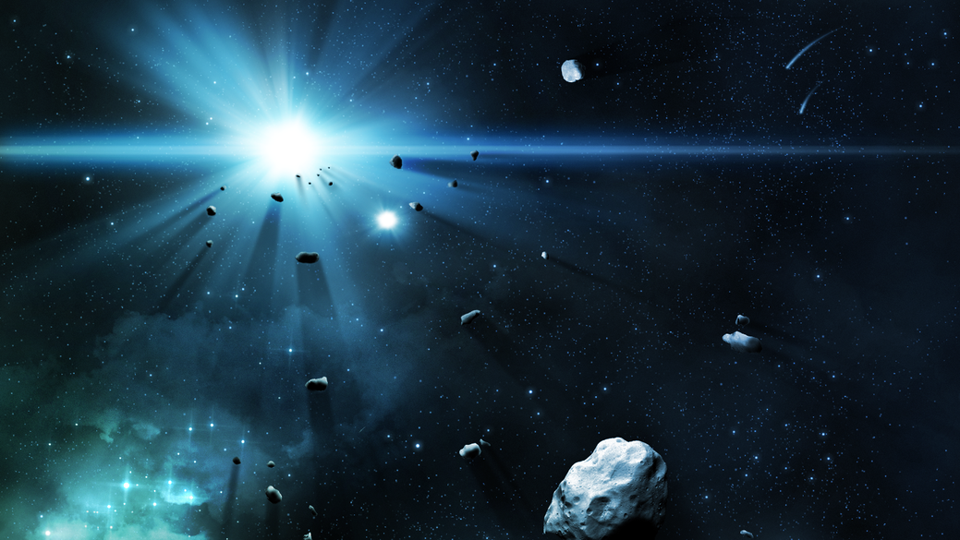
Hazardous Asteroids prediction
By:
A20466182 - Niveditha Mangala Venkatesha
A20293727 - Saipooja Kandala
A20496724 - Kajol Tanesh Shah
A20482282 - Sravani Bollisetti
A20473893 - Surya Thatee

Slide 2

Because that's when they're meteor!!
Why don't we eat asteroids until they get to Earth?

Slide 3

1. Overview

Slide 4
▸ “We’re smashing into an asteroid,” NASA’s Launch Services Program senior launch director Omar Baez said regarding SpaceX rocket Falcon 9, launched on Wednesday to deviate the path of the asteroid DART. The whole mission was the first planetary defense test mission from near-Earth objects.
▸ The objective of our project is to create a model is used to determine if these near-Earth objects i.e., asteroids are hazardous or not.
Why do we need this model? Ans. To save dinosaurs!!!

Slide 5
Questions:
What effect do the dataset's other attributes have on determining whether an asteroid is hazardous or not?
Determining whether an asteroid is dangerous or not?
Classifying asteroids according to orbit classes and determining which orbit classes contain hazardous asteroids?
Future work
▸ Improve our model to reduce test error
▸ Build some non-linear models and compare their result with our current model.

Slide 6
Challenges
▸ Data Cleansing and Preparation
▹ Finding redundant features
▸ There's way too much data
▸ High number of features ▹ Difficult to understand and interpret
▸ Resource limitations ▹ RStudio Crashing

Slide 7
2. Data Preprocessing

Slide 8
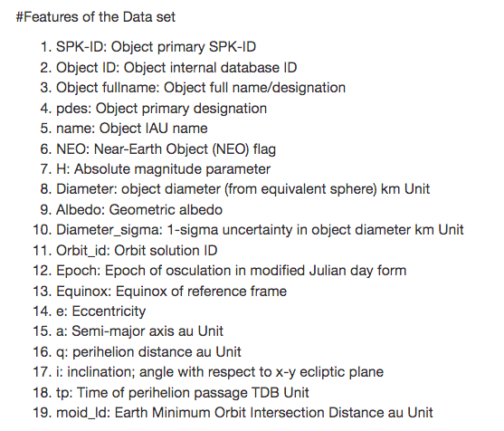
Features of the data

Slide 9
2.1. Data Preparation:
Our Solution:
Step 1: Find missing values
Step 2: Find null values
Step 3: Remove redundant values
958524 , this is too much data

Slide 10
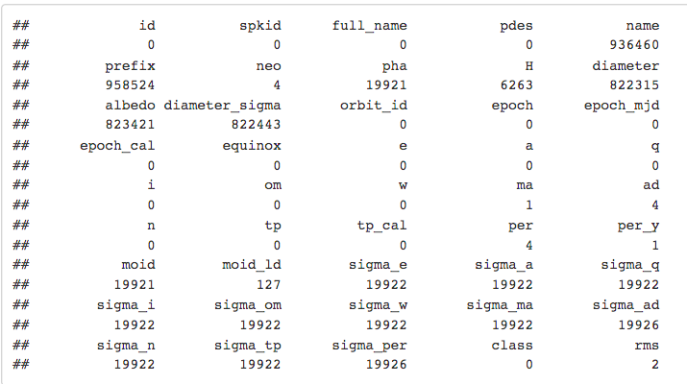
Find Missing Values:
The features name, prefix, diameter, albedo, diameter sigma are having missing values.

Slide 11
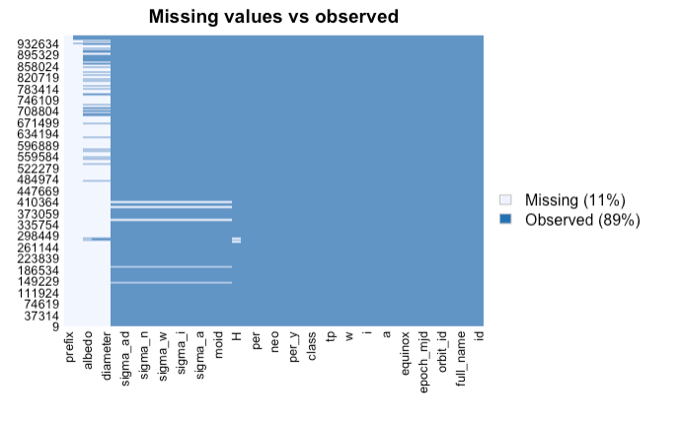
Finding Null/NA values:

Slide 12
What about Null values? We take care of them in 2 ways
Approach 1: Replacing them with the mean
Approach 2: Removing them

Slide 13
Which approach to choose?
To arrive at a conclusion, we first examined how much data we would use in the end to create and test our model.
Approach 1: Train: 750880, Test: 187719
Approach 2: Train: 104914, Test: 26228
We can see that when we remove the null values, a lot of data is lost, and we still can't decide which approach is better without knowing how they will perform in models. So we implemented both ways to come to a conclusion which we'll discuss later on in the presentation.

Slide 14
3. Data Visualization

Slide 15
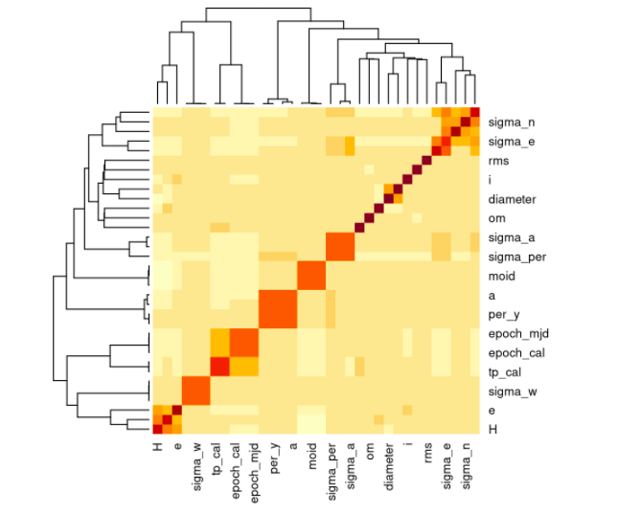
Heat map:
We can see that there are some features which are correlated with each other which means that they can be removed
Correlated sets:
Epoch, epoch_mjd. Drop epoch_mjd and epoch_cal
tp_cal, tp. Drop the tp_cal
Per, per_y. Drop per_y
Moid, moid_ld. Drop moid_ld

Slide 16
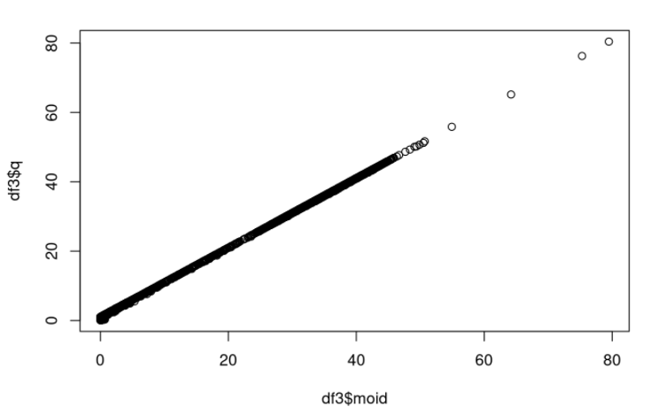
Finding Relations between features.
Since there is a linear relation between moid and q. we can drop column q

Slide 17
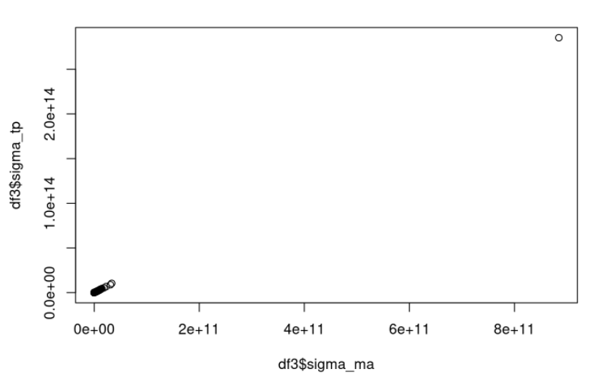
As we can see above sigma_ma and sigma_tp is not linear we will not drop either of them.

Slide 18
4.Model

Slide 19
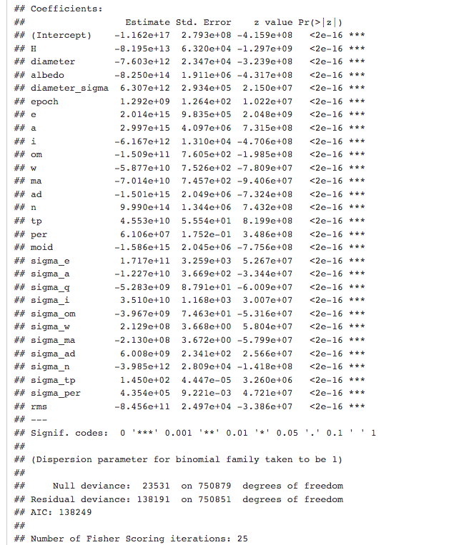
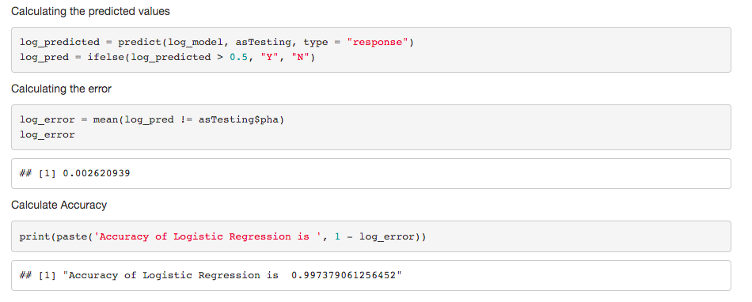
Logistic Regression

Slide 20
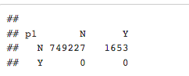
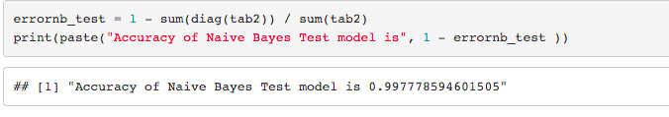
Naïve Bayes Model

Slide 21
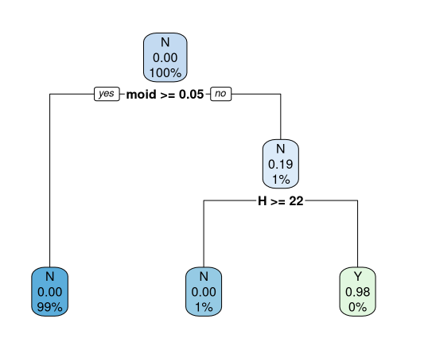
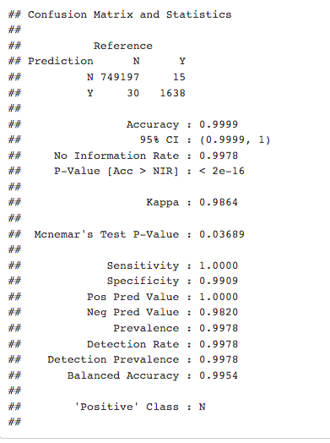
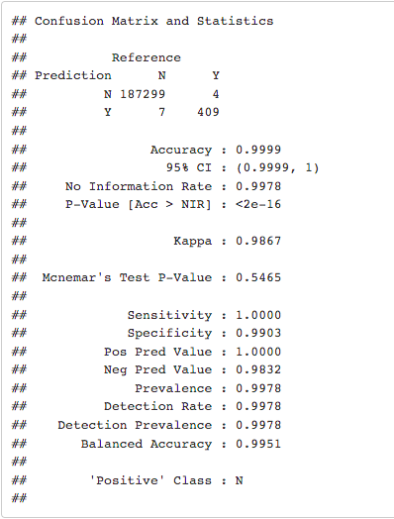
Decision Tree

Slide 22
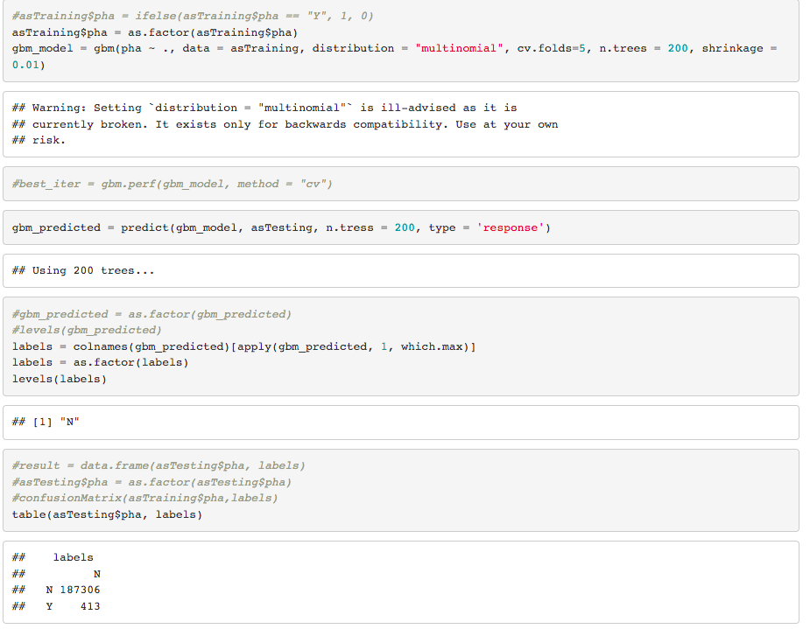
GBM

Slide 23
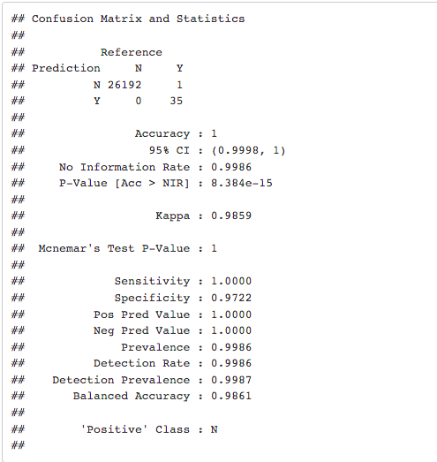
Support Vector Machine

Slide 24
So, What do these models mean?
We can see from before Naïve Bayes, Logistic regression, and GBM had 0 True positives. That is they couldn't even predict one hazardous asteroid.
Note: Regarding the null values, we used both approaches to see which produced a better model. We discovered that the models for both approaches have the same accuracy, but the values of true positives in the confusion matrix were low because a lot of data was lost in approach 2. As a result, we used Approach 1 to replace the null values with their mean, which resulted in better models which were the models explained above.

Slide 25
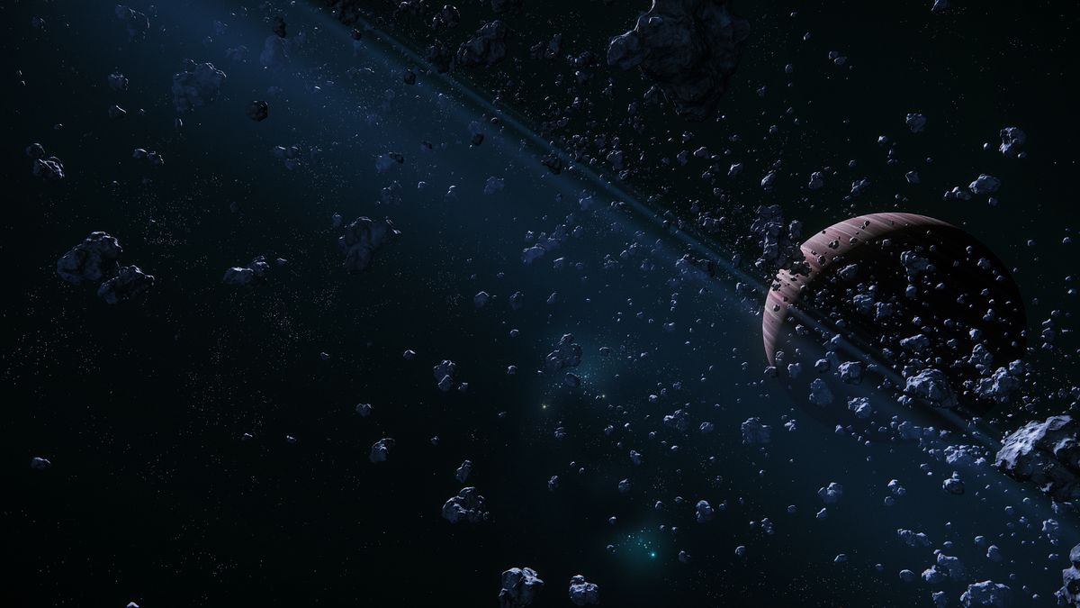
The model that can save us by predicting correctly is...
Finally...

Slide 26
Decision tree
The confusion matrix revealed that the model predicted 409 true positives. It was able to correctly predict 409 dangerous asteroids. Despite having some false positives and false negatives, this model was the best of all.
This is due to the fact that in the decision tree, all of the features are considered, and various split points are trined and tested using a function. The split with a yes value is chosen. As a result, the decision tree outperforms other models.

Slide 27

Thank you!

